Slide 1
CptS 327
Authentication
Notes:
Template-WSU Hrz 201.ppt

Slide 2
Today’s Topics
Authentication
Message Authentication Codes
Digital Signatures
Notes:
Template-WSU Hrz 201.ppt

Slide 3
Authentication
An application of cryptographic mechanisms
Overview:
  Definition
  Factors
  Threats
  Storage
  Protocols
Notes:
Template-WSU Hrz 201.ppt

Slide 4
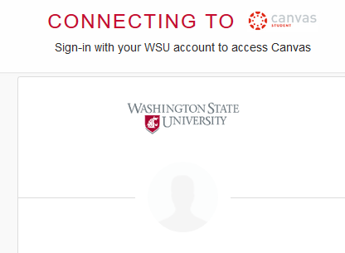
Authentication – Definition
“The process of verifying an identity claimed by or for a system entity”
learn.wsu.edu/
Student
????
Notes:
Template-WSU Hrz 201.ppt

Slide 5
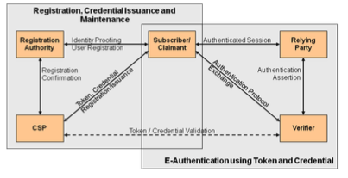
Authentication – E-Authentication
Developed by NIST
  Registration Authority – Trusted Entity that establishes and vouches for the identify or attributes of a Claimant/(Subscriber) to a CSP
Claimant/(Subscriber) – the party whose identity is to be verified with an authentication protocol
  Relying Party – Entities that depends upon the claimant (subscribers) credential or a Verifier’s assertion of a claimants identity.
Assertion - statement from a Verifier to a Relying Party (RP) that contains identity information about a Subscriber
  CSP (Credential Service Provider) – trusted entity that issues credentials to the Claimant/subscriber
  Verifier – party that verifies the identity of claimant
Credential – data structure that authoritatively binds an identity to a token, can be verified when presented to verifier during transaction
Token - Something that the Claimant possesses and controls (typically a cryptographic module or password) that is used to authenticate the Claimant’s identity.
Notes:
Template-WSU Hrz 201.ppt

Slide 6
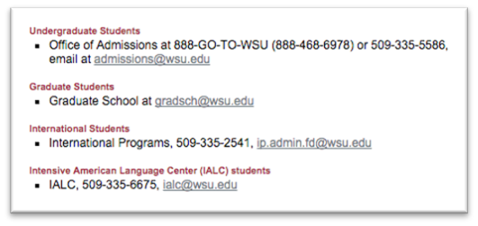

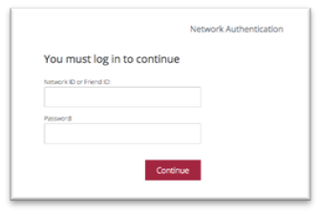
Authentication – E-Authentication
Developed by NIST
Admissions/Grad School/ International Programs
learn.wsu.edu/
Student
WSU ITS
shibidp.wsu.edu
Notes:
Template-WSU Hrz 201.ppt

Slide 7
Authentication - Factors
How do we authenticate? Using factors
Factors:
  Something you know
    Password, pin, security Q/A
  Something you possess
    Smart card, token generator
  Something you are
    Static: fingerprints, iris scan, face recognition
    Dynamic: voice recognition
Multifactor (2FA, 3FA) is the new norm
  Prevents single point of failure
Notes:
Template-WSU Hrz 201.ppt

Slide 8
Authentication - Levels
As defined by NIST:
  Level 1 – no ID proofing, 1FA
  Level 2 – ID proofing, 1FA
  Level 3 – ID proofing, 2FA (password, token)
  Level 4 – ID proofing, 2FA+ (password, token, iris scan,…)
Notes:
Template-WSU Hrz 201.ppt

Slide 9
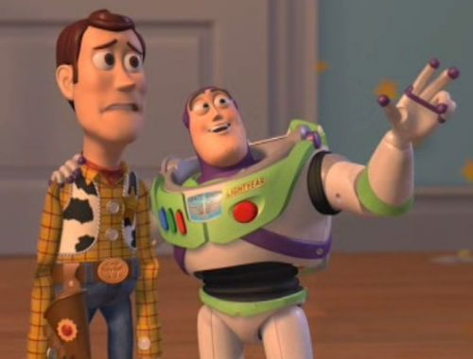


Notes:
Template-WSU Hrz 201.ppt

Slide 10
Passwords
Most popular: cheap and easy
Password quality/strength
  Length
  Diversity of characters
  Non-dictionary words
Strength can be measured using entropy
  Entropy: bits taken to store all possible combinations
Notes:
Template-WSU Hrz 201.ppt

Slide 11





Entropy
How many bits are need to represent the information?
Randomly Selected Passwords:
H - entropy
l - password length
b - characters in alphabet
- Binary value [0,1]
- Alphabet [a-z]
Example:
8 character ASCII
- All ASCIIs
User Selected Passwords:
Source: NIST 800-63 Rev 2
- First character = 4 bits
- Next 7 characters = 2 bits/character
- 9th -> 20th characters = 1.5 bit/character
- After 20th character = 1 bit/characters
And…
- Bonus 6 bits if check for dictionary words
- Bonus 6 bits if uppercase and non-alphabetic
What’s the entropy of English?
- We know P(e,t,a,o)>>P(j,q,x,z)
- Entropy of English words ~= 2.6 bits
Notes:
Template-WSU Hrz 201.ppt

Slide 12
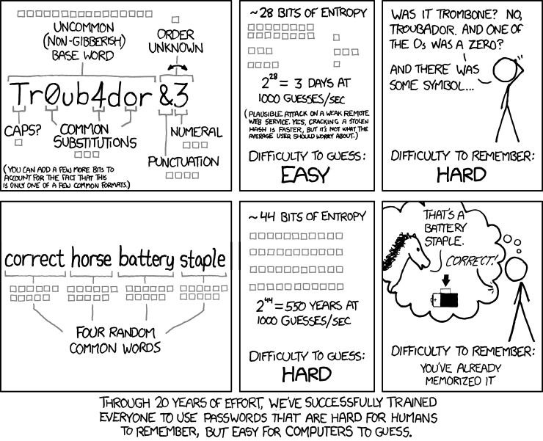
Notes:
Template-WSU Hrz 201.ppt

Slide 13
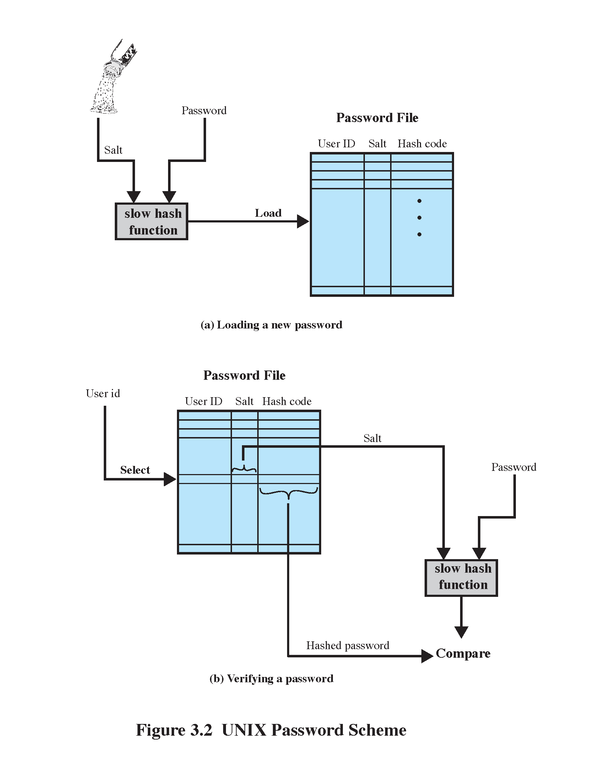
Storing Passwords - Password Hashes
Hash Usage
Hash Creation
Example: OpenBSD (55 chars, 128bit salt, 192bit hash)
Notes:
Template-WSU Hrz 201.ppt

Slide 14





Authentication Threats
What Threats Exists?
Hacker
Network
Credential
Verifier/
Target System
Claimant
Host System
Notes:
Template-WSU Hrz 201.ppt

Slide 15
Authentication Threats
Hacker
4) Denial of Service
5) Replay
6) Eavesdrop
Steal Token
Guess Token
Network
7) Host Attack
3)Trojan/Malware
Credential
Verifier/
Target System
Claimant
Host System
Notes:
Template-WSU Hrz 201.ppt

Slide 16
Authentication Threats
-Password written down
-Passwords reused
-Default blank/known passwords
-Brute force guess
-Unencrypted transmission
-Offline password hashing
http://arstechnica.com/security/2013/05/how-crackers-make-minced-meat-out-of-your-password
-Keylogger
4) Denial of Service
5) Replay
6) Eavesdrop
Steal Token
Guess Token
Network
7) Host Attack
3)Trojan/Malware
Credential
Verifier/
Target System
Claimant
Host System
Notes:
Template-WSU Hrz 201.ppt

Slide 17
MACs
Message Authentication Codes
NOT Media Access Control
Provide integrity and authentication
Can be used independently or alongside encryption
Notes:
Template-WSU Hrz 201.ppt

Slide 18
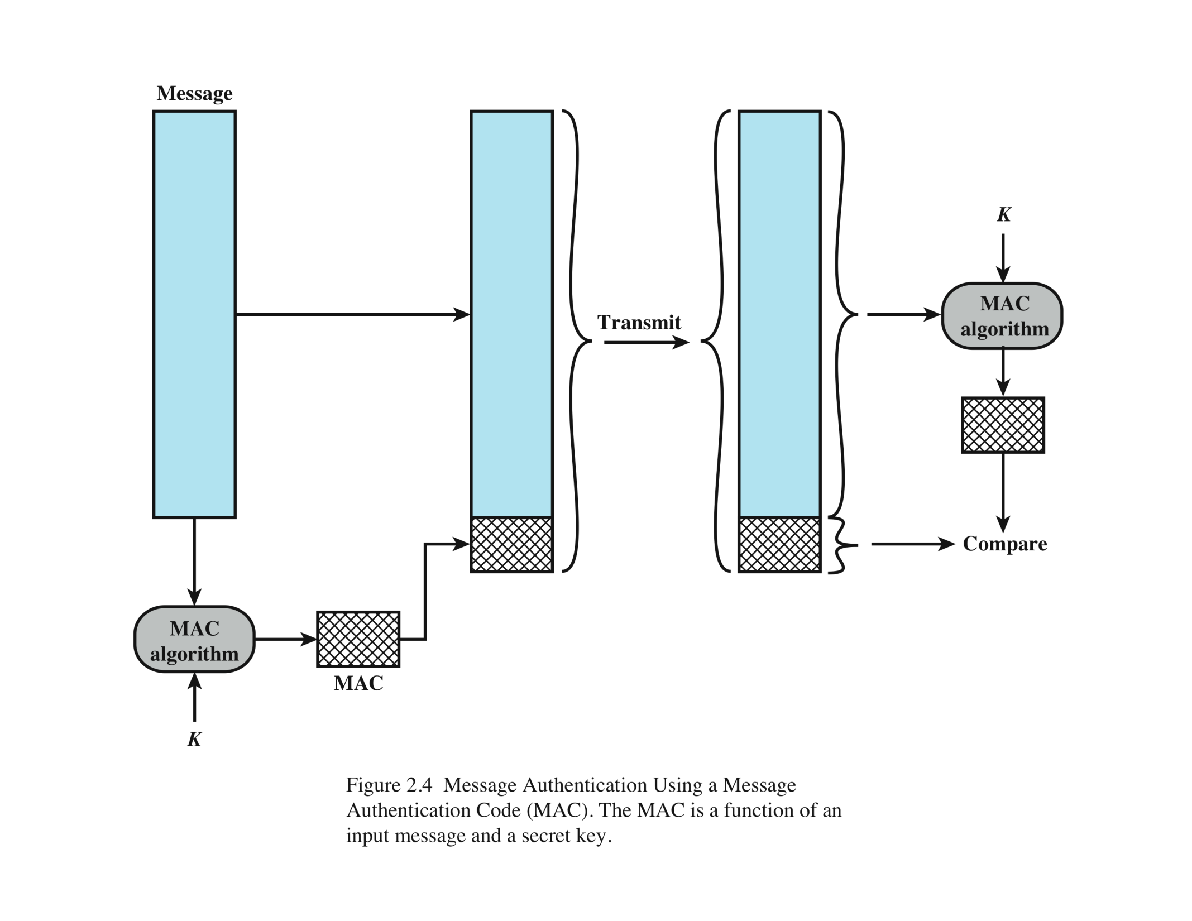
MAC
Alice
Bob
(M)
MACM = F(K,M)
MACM = F(K,M)
M
Preshared Key
Notes:
Template-WSU Hrz 201.ppt

Slide 19
MAC Security
Integrity
  If message is manipulated in transit, MACs don’t match
  F(K, M) != F(K, M’)
Authentication
  The preshared key, K, provides authentication
Drawbacks
  Key management
  Repudiation (everyone that can access K can create the same MAC)
Notes:
Template-WSU Hrz 201.ppt

Slide 20
Digital Signatures
Provide authenticity and integrity
Uses asymmetric encryption
Recall:
  A member’s public key is available for everyone in the group
  A member’s private key is available to only the member
Notes:
Template-WSU Hrz 201.ppt

Slide 21
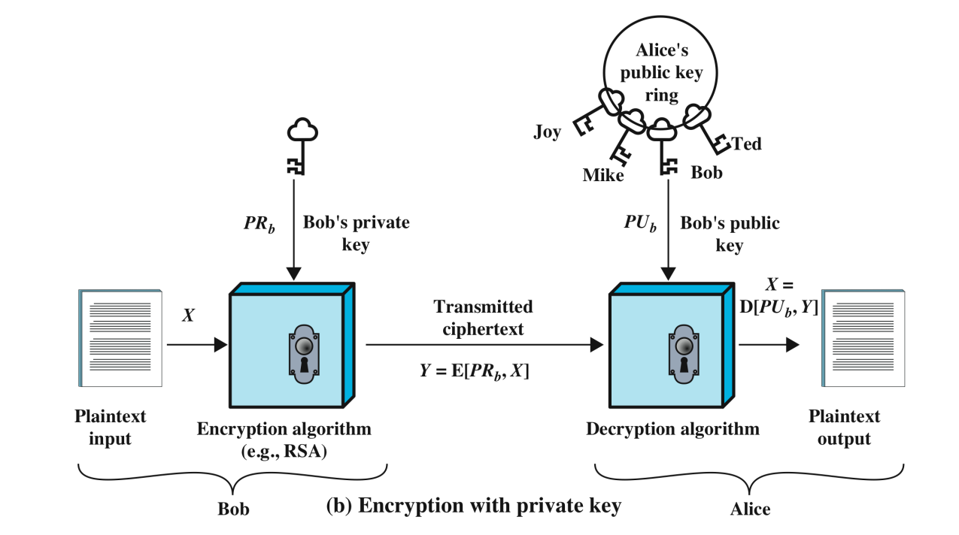
Notes:
Template-WSU Hrz 201.ppt

Slide 22
Digital Certificates
Provide root of trust
Helps protect against spoofing / tampering
Relies on a central certification authority (CA)
  VeriSign, Comodo, …
If CA is compromised, the entire trust chain is vulnerable
Notes:
Template-WSU Hrz 201.ppt

Slide 23
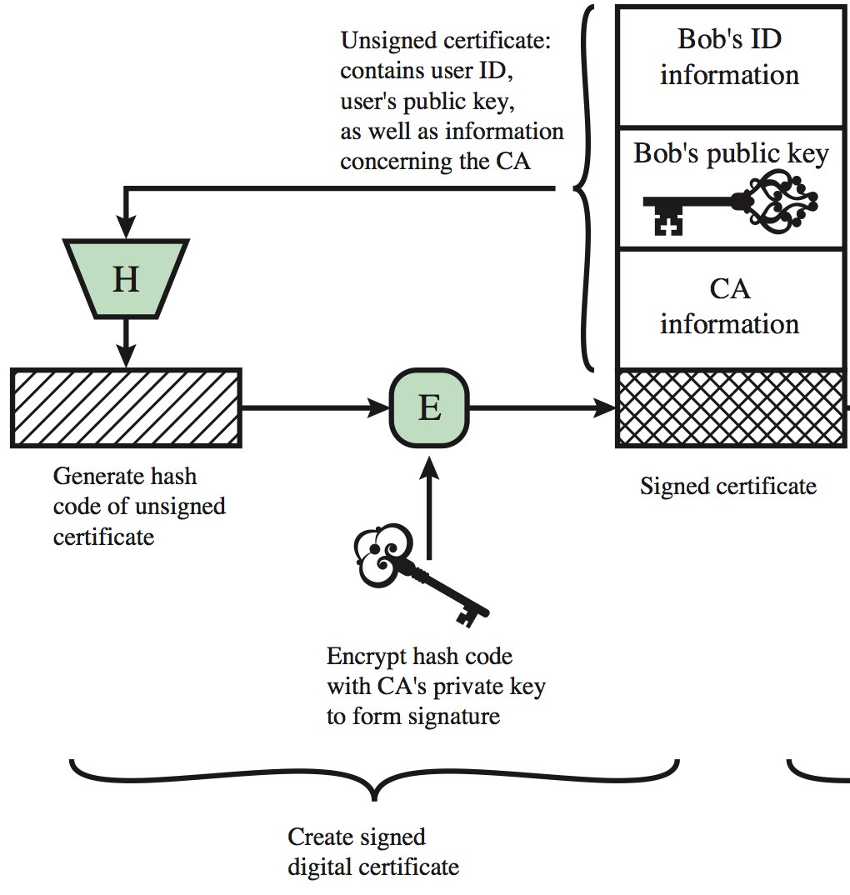
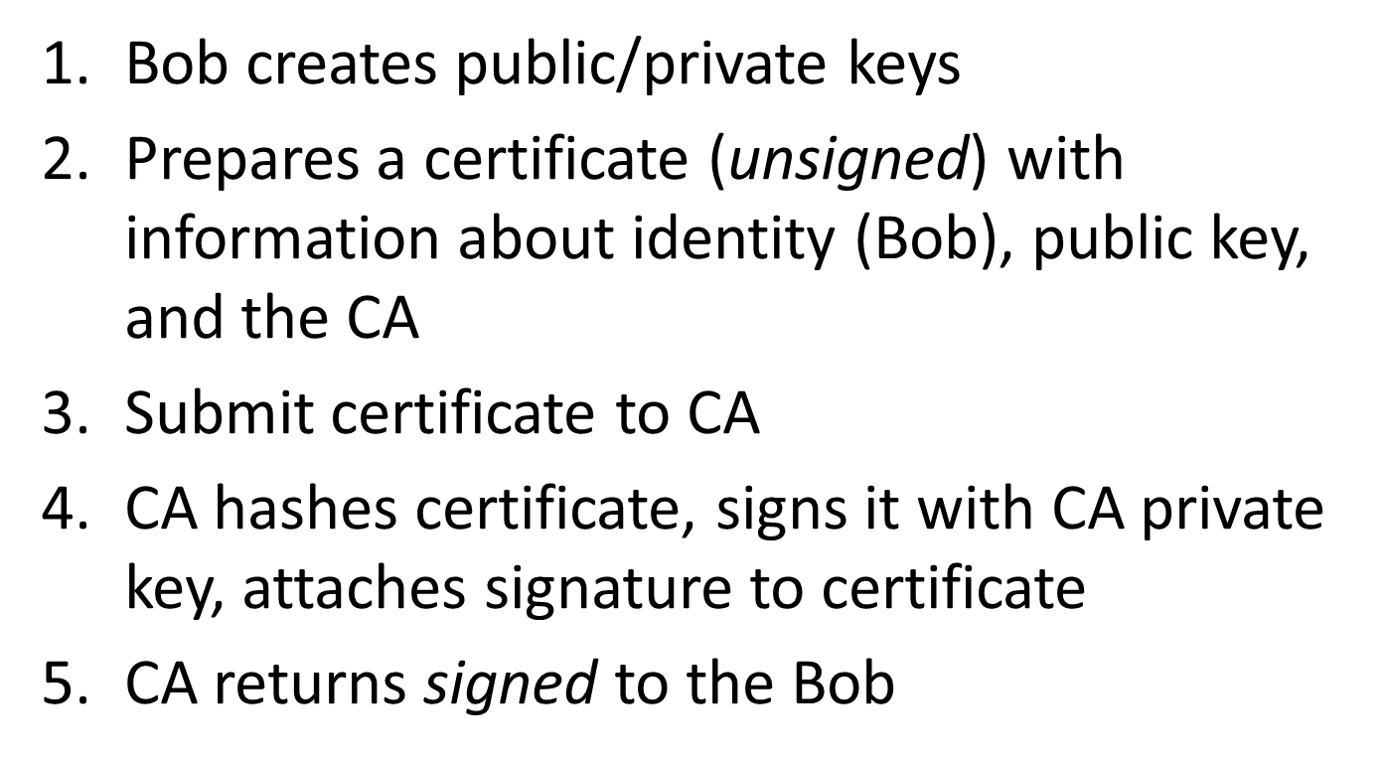
Digital Certificate Creation
Notes:
Template-WSU Hrz 201.ppt

Slide 24
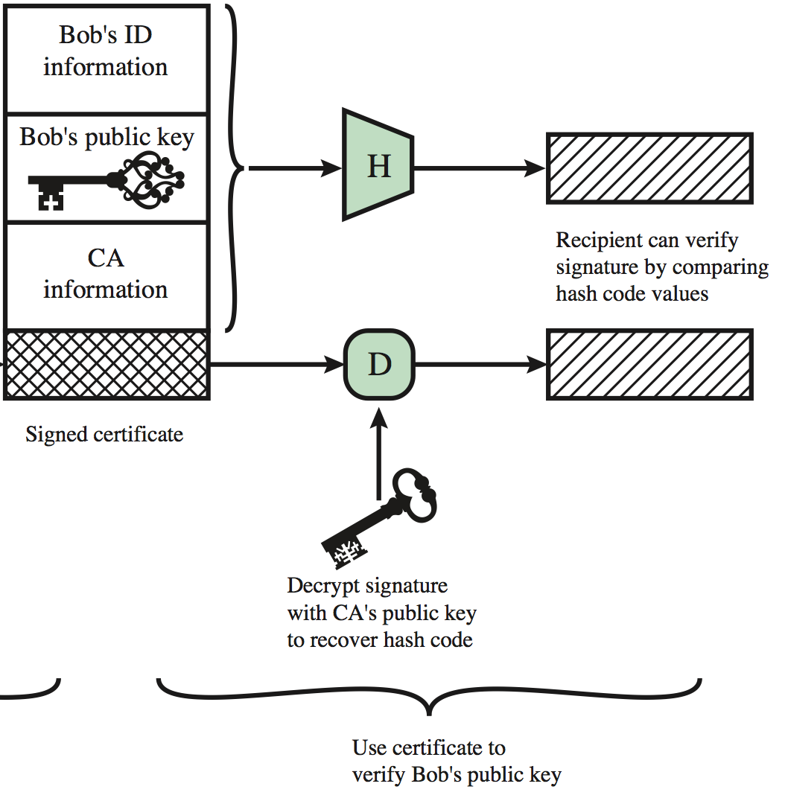
Digital Certificate Usage
Alice requests communication with Bob
Bob sends signed certificate to Alice
Alice (already has CA public key) creates hash of certificate, checks to see if the hash matches the CA signed part of certificate
If equal, cert has not been tampered with and public key in certificate can be trusted
If not equal, potentially spoofed/tampered communication!

Slide 25
Next lecture
Security questions
Biometrics
Tokens, and others auth factors
Auth protocols
Notes:
Template-WSU Hrz 201.ppt

Slide 26
Any questions?
Notes:
Template-WSU Hrz 201.ppt

